Slide 1
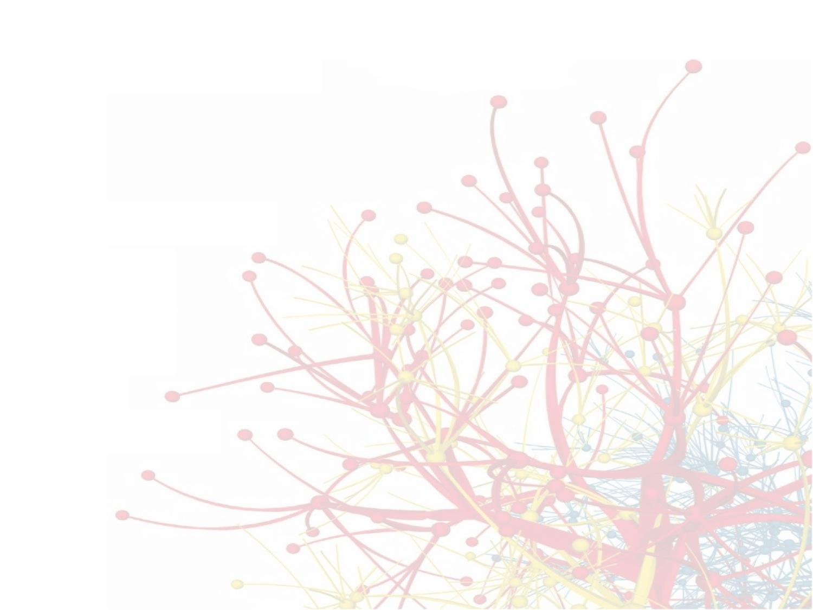

Web Science
Social Networks
Alexander C. Nwala
CS 432/532
Lecture 6 (2018-02-13)
Old Dominion University
This work is licensed under a Creative Commons Attribution-NonCommercial-ShareAlike 3.0 Unported License

Slide 2
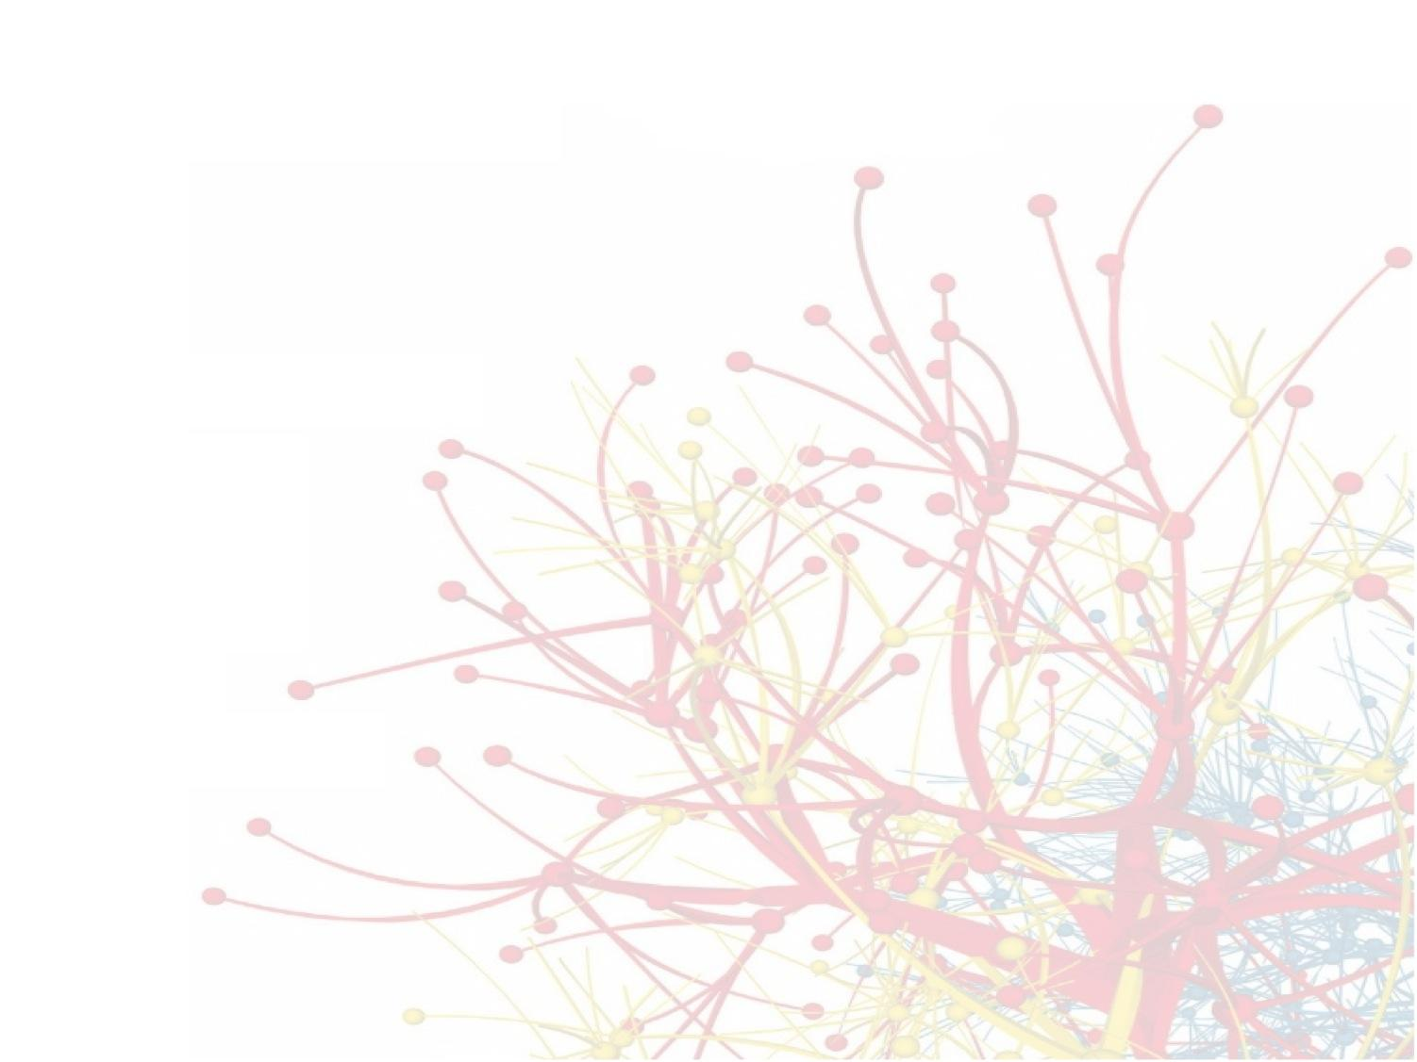
Social Networks
Michael L. Nelson
CS 432/532
Old Dominion University
This work is licensed under a Creative Commons Attribution-NonCommercial-ShareAlike 3.0 Unported License
This course is based on
Dr. McCown's class

Slide 3
Slides based on Ch 2 and 3 of Networks, Crowds and Markets by Easley & Kleinberg (2010)
http://www.cs.cornell.edu/home/kleinber/networks-book/

Slide 4
Social Network
Definition: Graph composed of actors (people, organizations, groups) that are tied by social links
relationship
A
follows
B
actors

Slide 5
Online Social Networks (OSN)
Digital incarnation of a social network
Created by social network sites, social networking services
Web-based services that allows users to:¹
construct (semi-)public profiles within the system
"connect" to other users
view and traverse lists of connections created by others
¹Boyd & Ellison (2007) - Social Network Sites: Definition, History, and Scholarship

Slide 6









Slide 7
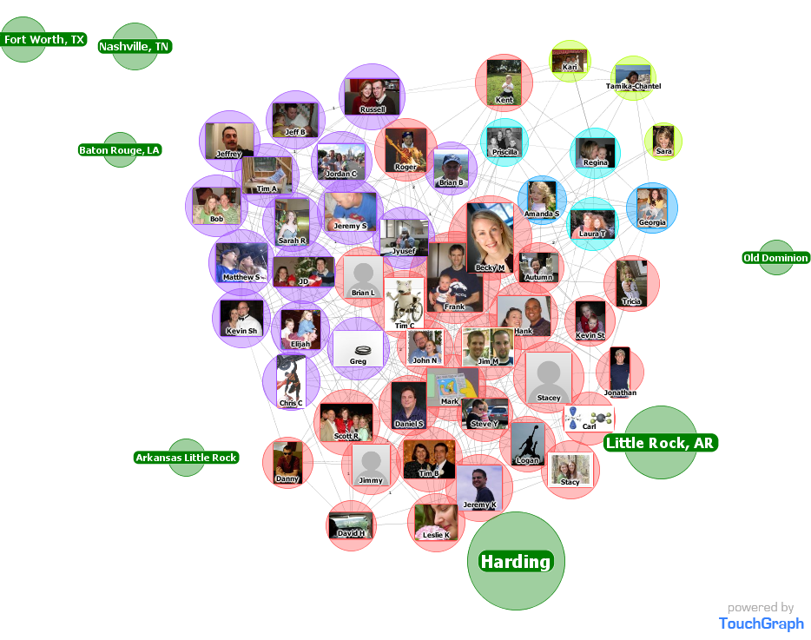
Facebook Friends

Slide 8
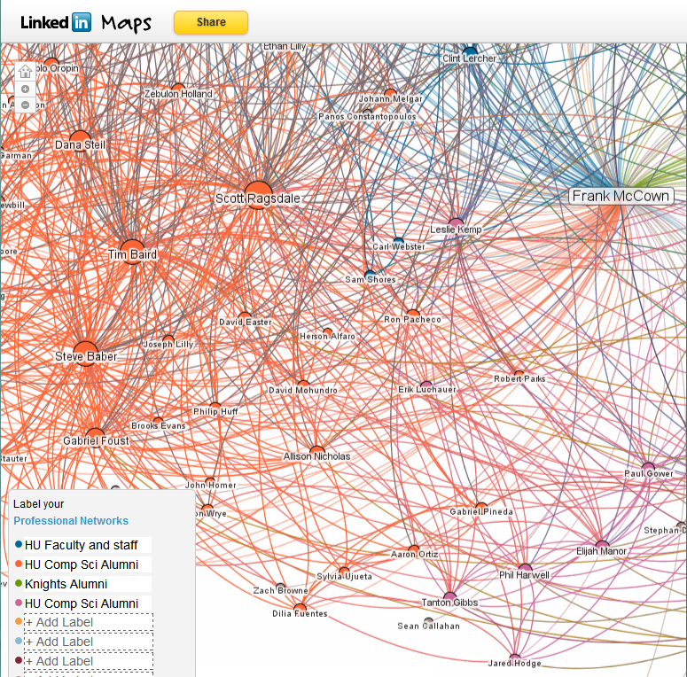
LinkedIn Maps

Slide 9
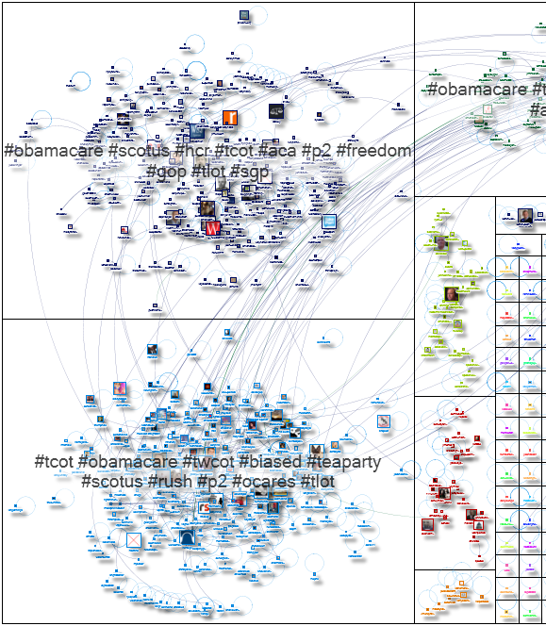
Tweets containing "obamacare"
http://www.nodexlgraphgallery.org/Pages/Graph.aspx?graphID=514

Slide 10
Why Study Social Networks?
Social scientists use social networks to study how people interact and develop theories of social behavior. OSNs offer opportunities to study social networks at larger scale
Understanding the structure of OSNs can lead to systems in the future that want to improve security, leverage trust, improve social interaction, etc.

Slide 11
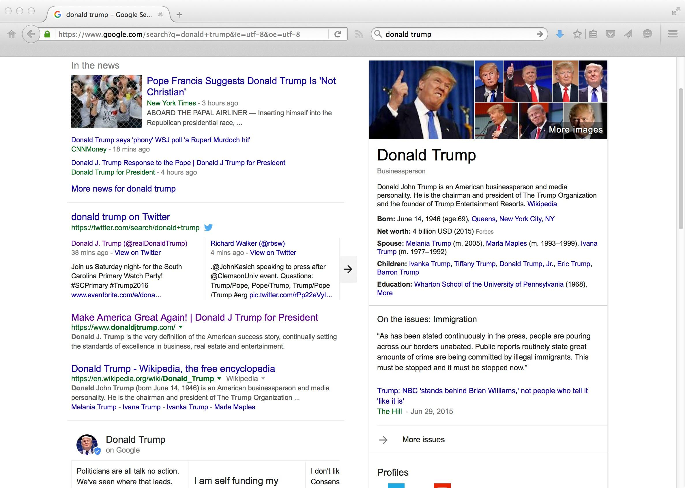
Social Media Is An Important Vertical
¹http://googleblog.blogspot.com/2011/03/1s-right-recommendations-right-when-you.html

Slide 12
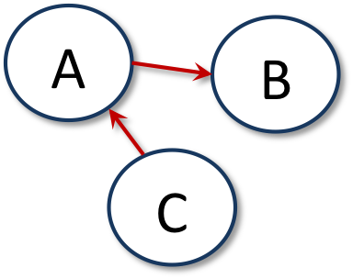

Graph Types
Directed
Undirected
e.g., Twitter followers
e.g., Facebook friends

Slide 13
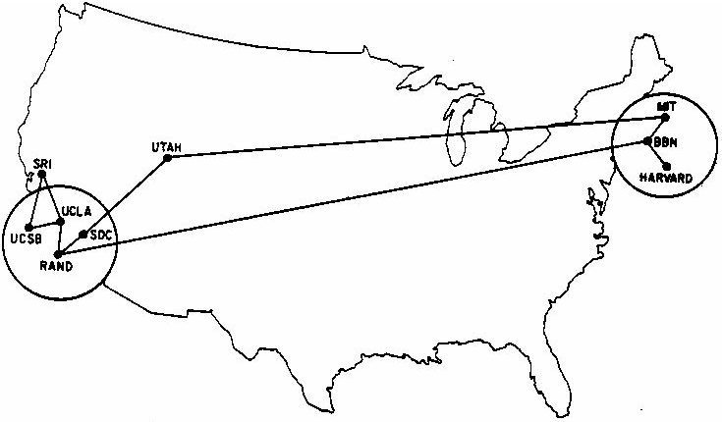
Cycles
Shortest cycle
The Internet - June 1970
http://som.csudh.edu/cis/lpress/history/arpamaps/press6.jpg

Slide 14
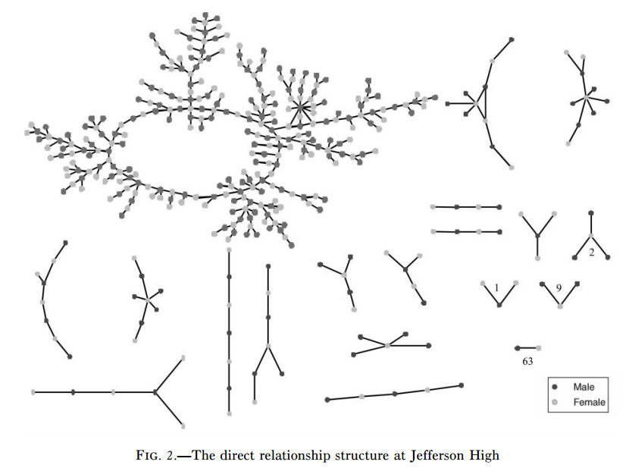
Components
Giant component
Bearman, et al., Chains of Affection: The Structure of Adolescent Romantic and Sexual Networks (2004)

Slide 15
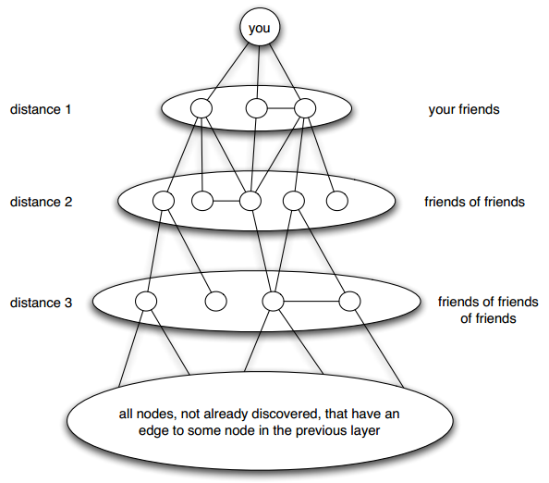
Distance
Length of shortest path
Breadth-first search
Easley & Kleinberg, Fig 2.8

Slide 16
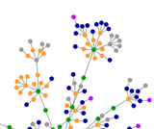
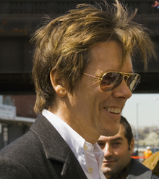
Small World Network
Six degrees of separation
From title of play by John Guare
First tested by Stanley Milgram in 1960s who found median length of 6 between two individuals
Six degrees of Kevin Bacon
OSNs make studying this phenomena a little easier
http://en.wikipedia.org/wiki/Six_Degrees_of_Kevin_Bacon
http://oracleofbacon.org/

Slide 17
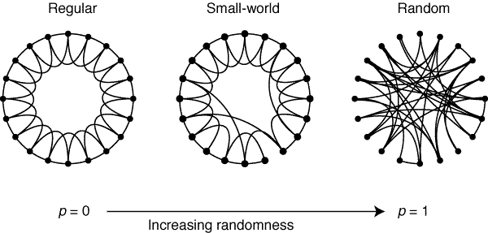
Regular → Small World → Random
Watts & Strogatz, Nature, 1998, http://dx.doi.og/10.1038/30918
Notes:
See: http://worrydream.com/refs/Watts-CollectiveDynamicsOfSmallWorldNetworks.pdf

Slide 18
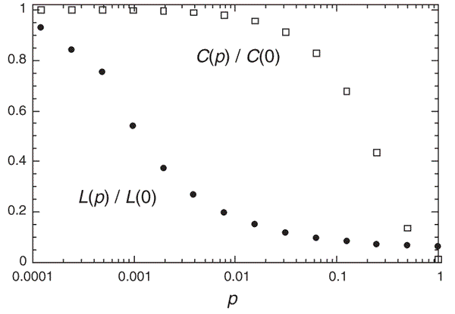
Small World = big CC, low L_{G}
Watts & Strogatz, Nature, 1998, http://dx.doi.org/10.1038/30918

Slide 19
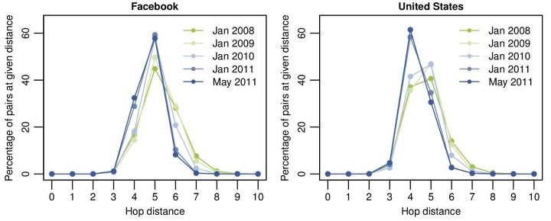
Four Degrees of Separation
Study of all Facebook users (721 million) in 2011 revealed avg distance of 4.74
https://www.facebook.com/notes/facebook-data-team/anatomy-of-facebook/10150388519243859

Slide 20
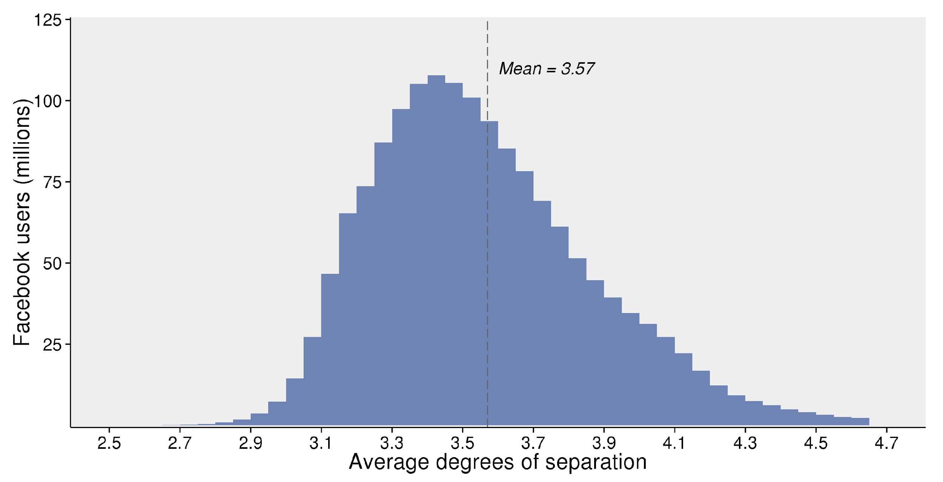
2016 Update: 3.57 Degrees
https://research.facebook.com/blog/three-and-a-half-degrees-of-separation/

Slide 21
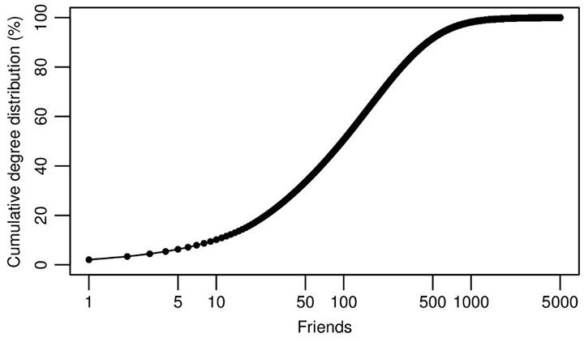
How Many Friends?
https://www.facebook.com/notes/facebook-data-team/anatomy-of-facebook/10150388519243859
example of a CDF: https://en.wikipedia.org/wiki/Cumulative_distribution_function

Slide 22
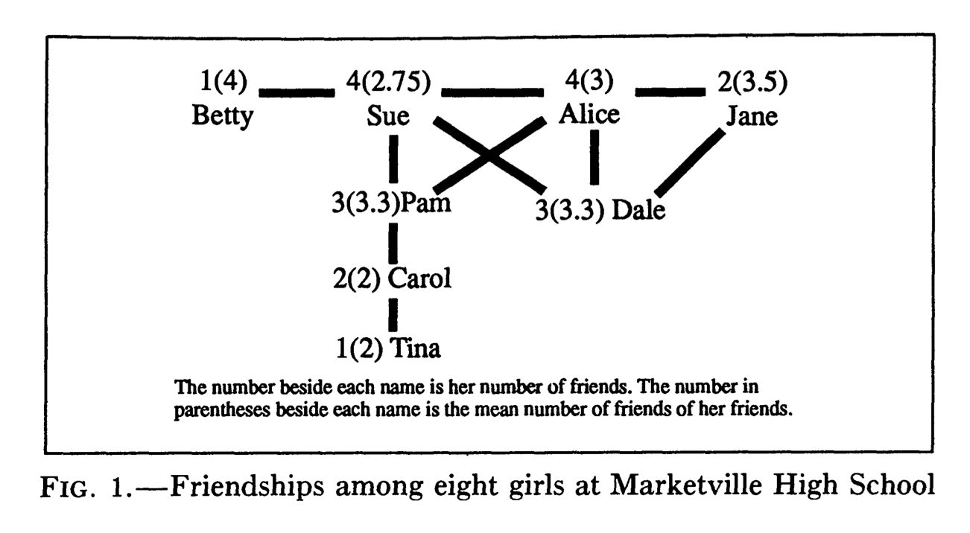
"Friendship Paradox"
Fun fact: your friends have more friends than you do.
http://www.jstor.org/pss/2781907
http://www.uvm.edu/~pdodds/teaching/courses/2009-08UVM-300/docs/others/everything/feld1991a.pdf
http://en.wikipedia.org/wiki/Friendship_paradox
Your friends are also happier than you: http://arxiv.org/abs/1602.02665
Notes:
See: https://www.youtube.com/watch?v=y10JZviXZqs

Slide 23
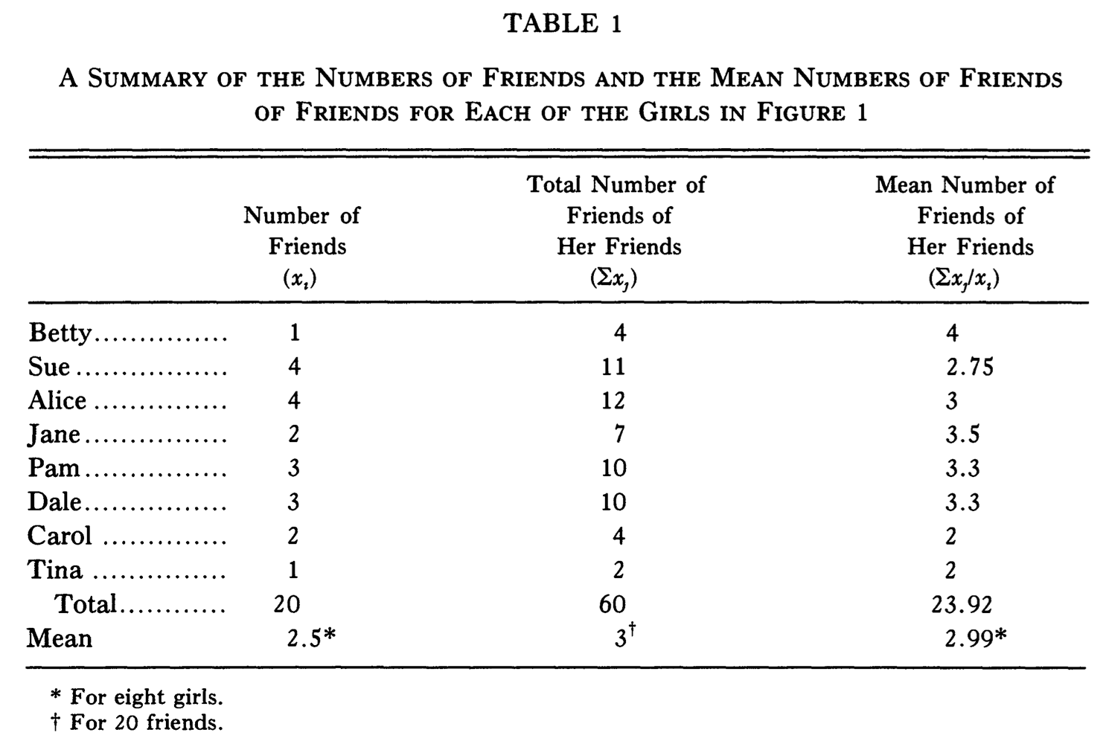
Sue & Alice Rule Marketville
(Carol is doing ok)

Slide 24
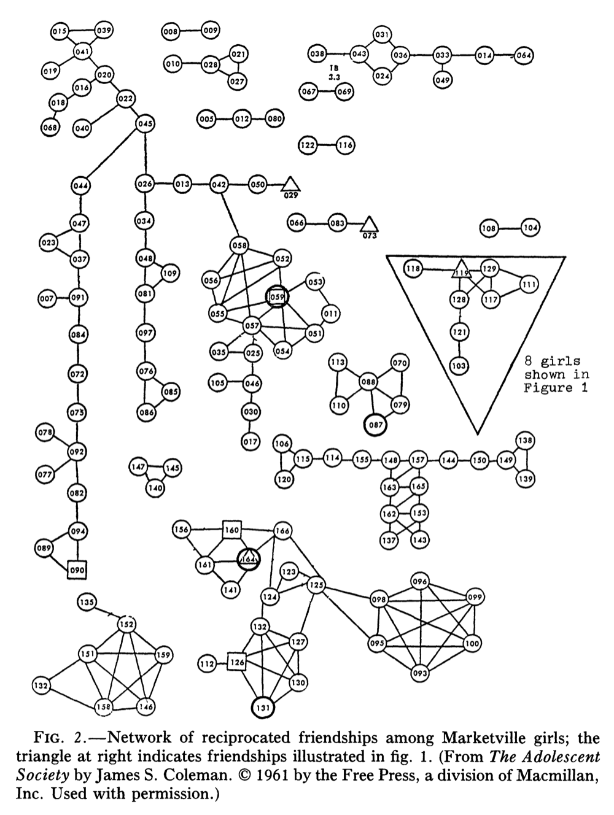
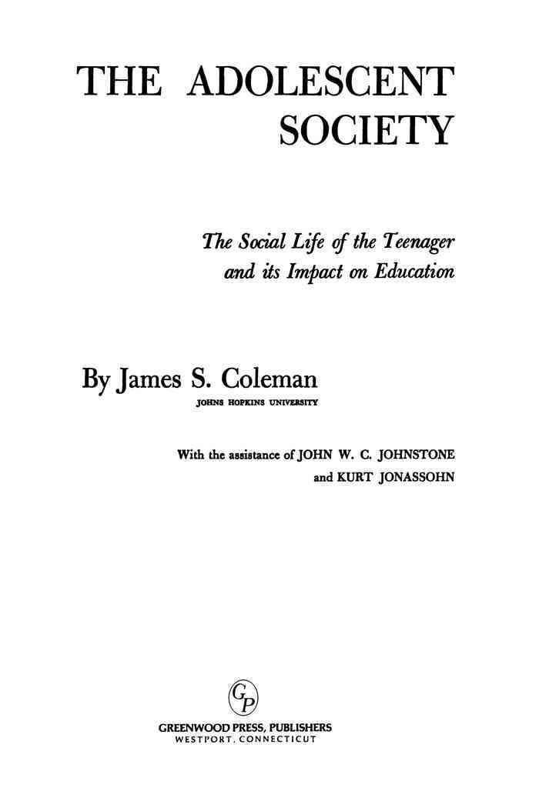
Complete Network
of Marketville
In 1961 study, friendship is via bi-directional
naming in a questionnaire (i.e., Facebook style).

Slide 25
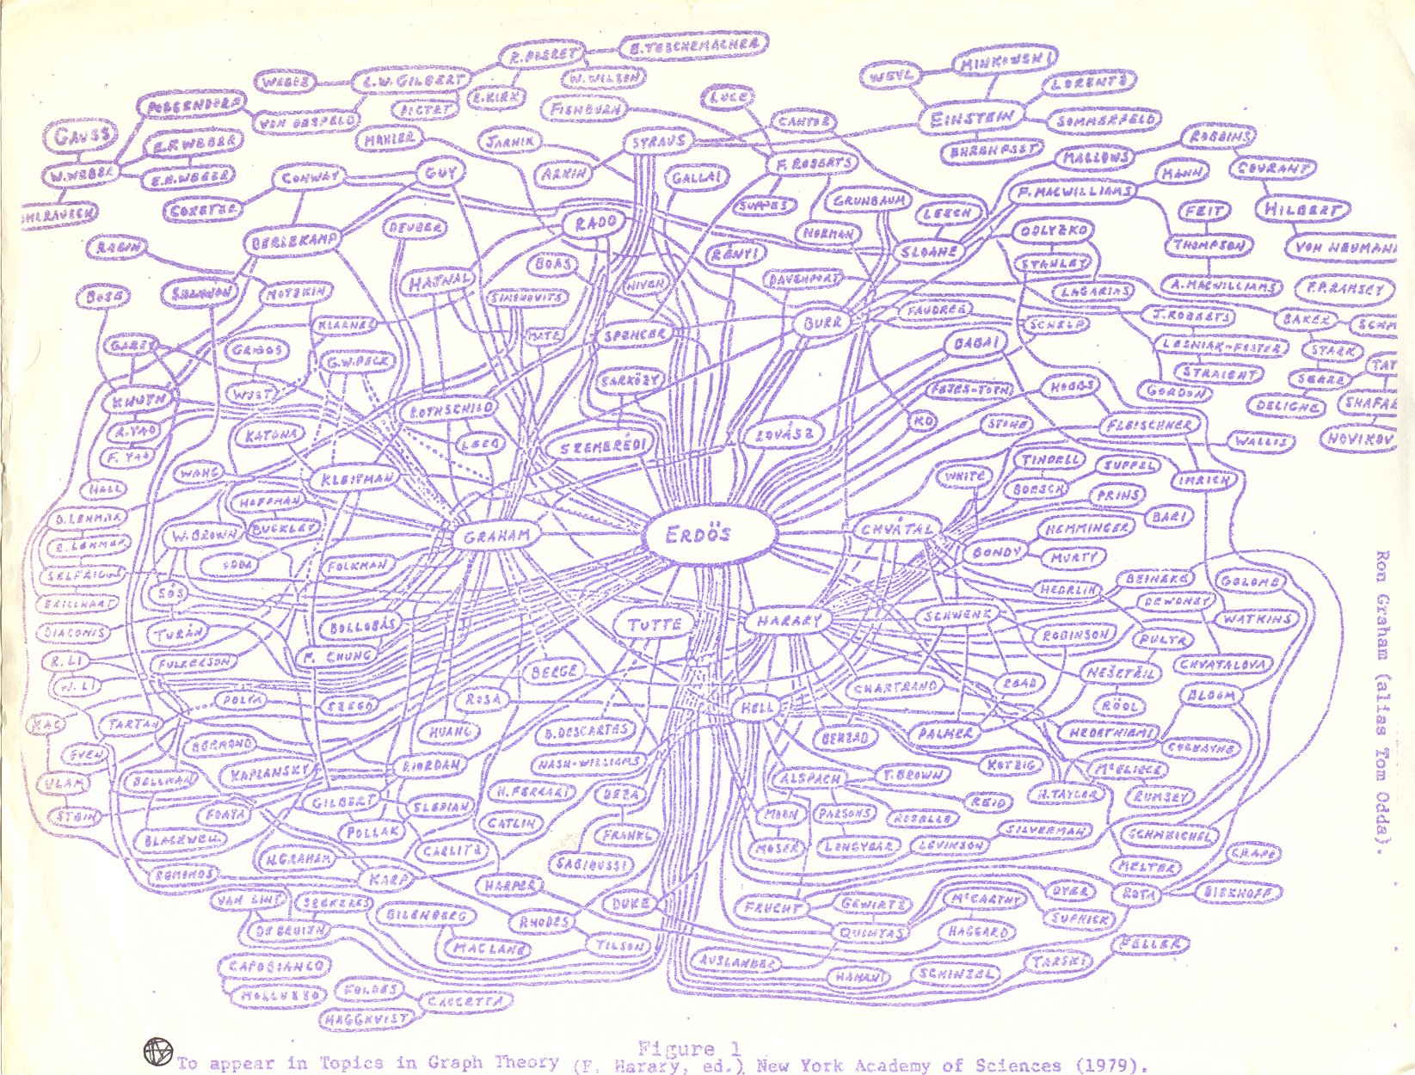
Erdos Number
Ron Graham's hand-drawn graph
http://www.oakland.edu/enp/trivia/
https://en.wikipedia.org/wiki/Paul_Erd%C5%91s

Slide 26
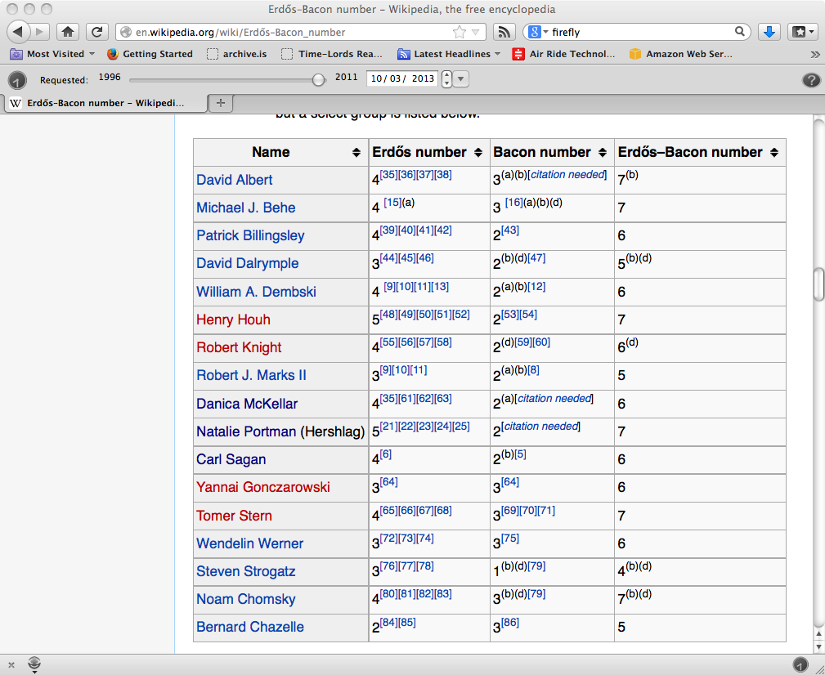
Erdos-Bacon Number
http://en.wikipedia.org/wiki/Erd%C5%91s%E2%80%93Bacon_number
http://www.cs.odu.edu/~mln/pubs/

Slide 27
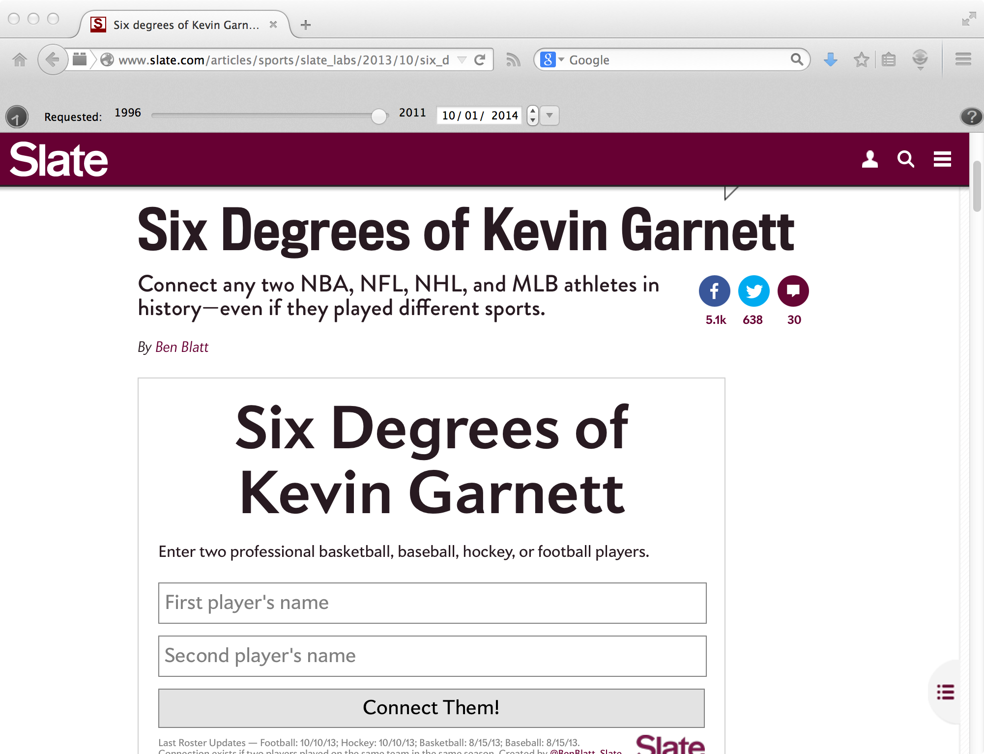
Garnett Number
http://www.slate.com/articles/sports/slate_labs/2013/10/six_degrees_of_kevin_garnett_connect_any_two_athletes_who_ve_ever_played.html

Slide 28
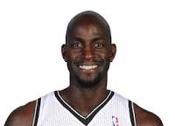



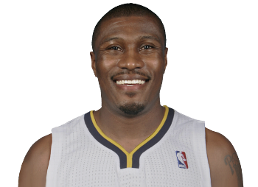
My (Dr. Nelson) Garnett Number = 5
(assuming "played against in pickup ball" counts)
(N.B. it really doesn’t)
Kevin Garnett
G=0
James Posey
G=1
Chris Gatling
G=2
Larry Wilson
G=3
Justin Brunelle
G=4
This gives me a Erdos-Bacon-Garnett number of 12!
Others may have a defined E/B/G number, but they are unknown.

Slide 29
Network Evolution
Social networks tend to change over time
You make new friends, lose contact with others
You change schools, jobs, etc.
We're often interested in examining multiple snapshots of the social graph through time

Slide 30
"If two people in a social network have a friend in common, then there is an increased likelihood that they will become friends themselves at some point in the future."
- Anatole Rapoport (1953)

Slide 31
``When I introduce you, I'm gonna say,
"This is a friend of mine."
That means you're a connected guy.
Now if I said instead, this is a friend of ours
that would mean you a made guy. A Capiche?''
Donnie Brasco
http://www.youtube.com/watch?v=Bnmt6dLasxw

Slide 32
Triadic Closure
Common friend
A
B
C
Likely to appear
Notes:
See: https://www.cs.cornell.edu/home/kleinber/networks-book/networks-book-ch03.pdf

Slide 33
Reasons for Triadic Closure
Opportunity – A spending time with B & C increases chance they will meet
Trust – Research shows that B & C are more likely to trust each other if they are aware of mutual friend A
Incentive – Research shows that latent stress occurs when mutual friends are not friends with each other

Slide 34
Measuring Triadic Closure
Clustering coefficient – probability that any two randomly selected friends of a node are also friends
= 0 when none of node's friends are friends with each other
= 1 when all of node's friends are friends with each other
# of friend pairs
CC for a node =
# of possible friend pairs

Slide 35
Clustering Coefficient
A's CC: BC / BC = 1
A
F's CC: - / BE = 0
B
C
D
F
C's CC: AB / AB, AD, BD = 1/3
E
CC for a node = # of friend pairs / # of possible friend pairs

Slide 36
Bridges
A
B
Edge is a bridge if removing the edge creates two components

Slide 37
Local Bridges
C
A
B
Edge is a local bridge if endpoints have no friends in common

Slide 38
Local Bridges
C
A
B
Removing a local bridge does not create two components!

Slide 39
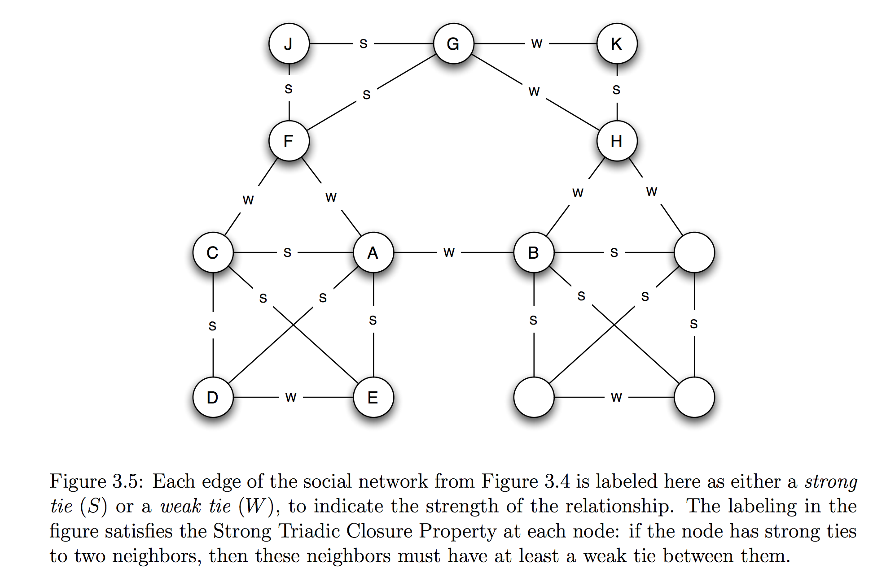
Strong and Weak Ties
Not everyone is your BFF!

Slide 40
Variable Tie Strength
0
10
6
C
1
9
A
B
Can use more fine-grained methods to determine tie strength, like number of Facebook messages exchanged

Slide 41
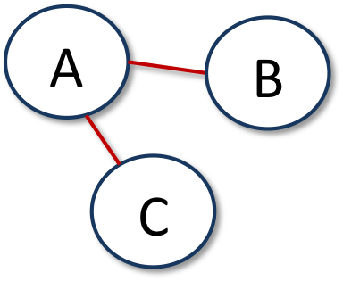
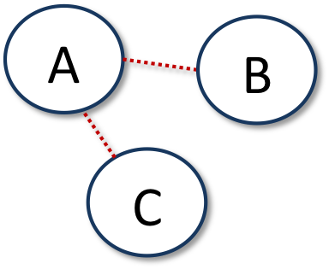
Tie Strength and Triadic Closure
More likely to form
Less likely to form
Triadic closure is more likely to form when initial edges are strong

Slide 42
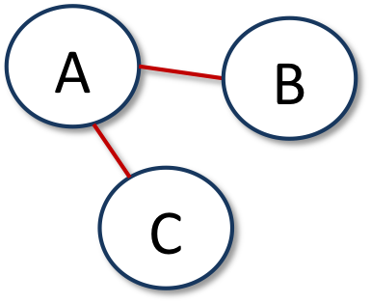
Strong Triadic Closure Property
Node A satisfies the Strong Triadic Closure Property if it has strong ties to two other nodes B and C, and there is some edge between B and C
satisfies
violates
A
B
C

Slide 43
Strong Triadic Closure and Bridges
Can a node with at least 2 strong edges satisfy the STC property and be involved in a local bridge that is a strong tie?
C
A
B
?
Answer: No! Why not?

Slide 44
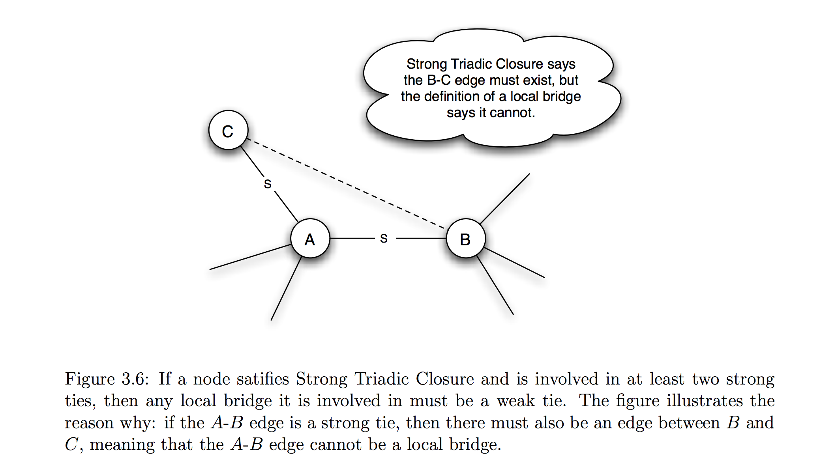
Strong Triadic Closure and Bridges
Can a node with at least 2 strong edges satisfy the STC property and be involved in a local bridge that is a strong tie?
Answer: No! Why not?

Slide 45
Strong Triadic Closure and Bridges
STC property says edge must form when two strong edges emanate from the same node
Therefore a network that satisfies the STC property and has a sufficient number of strong ties will likely have only weak local bridges
Does not always hold in real social networks, but useful theoretical framework in which to understand connections and test theories

Slide 46
Large-Scale Data Studies
Put new concepts to work by examining several large-scale studies
Examples:
Cell phone usage
Facebook
Twitter

Slide 47
Cell Phone Social Network
Onnela et al., Structure and tie strengths in mobile communication networks (2007)
18 weeks of cell phone data covering 20% of country's population
Node = cell phone user
Edge = if two nodes called each other (both directions)
Tie strength = duration of calls

Slide 48
Cell Phone Social Network
Instead of determining if edge is a local bridge or not, use neighborhood overlap
= 1 if all neighbors of A and B are connected
= 0 if no neighbors are connected (local bridge)
Close to 0 is "almost" a local bridge
Neighborhood overlap
neighbors of both A and B
=
neighbors of A or B

Slide 49
Neighborhood Overlap
D
C
E
A
B
F
G
Neighborhood overlap of AD
E
=
1/5
=
C, E, F, G, B

Slide 50
Neighborhood Overlap
D
C
E
A
B
F
G
Neighborhood overlap of AB
-
=
=
0
D, E, F, G, etc.

Slide 51
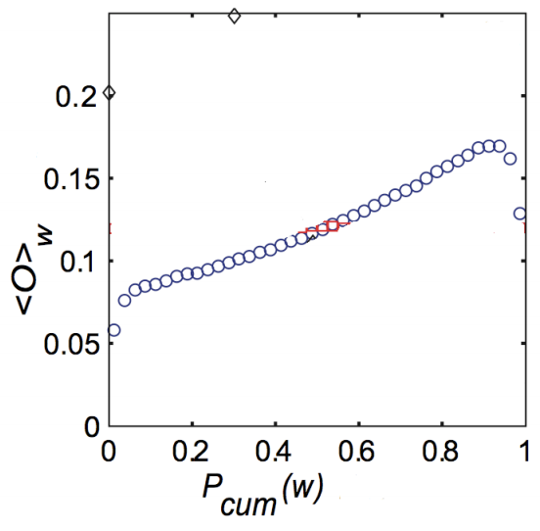
Neighborhood Overlap
Q: What's happening here?
A: We're not sure. Unusual
phone usage?
Onnela et al.'s findings
Tie Strength
http://www.cs.cornell.edu/home/kleinber/networks-book/networks-book-ch03.pdf

Slide 52
Removing Ties
84% of cell phone graph nodes lay in a single giant component
Do weak ties link strongly connected components?
Removed edges one at a time starting with strongest edges → giant component slowly erodes
Removed edges starting with weakest edges → giant component shrank quicker, remnants broke apart quickly once critical weak edges removed

Slide 53
Tie Strength on Facebook
Marlow et al., Maintained relationships on Facebook, 2009, http://overstated.net/2009/03/09/maintained-relationships-on-facebook
Analyzed tie strength of Facebook users using one month of interactions

Slide 54
Three Categories of Links
Reciprocal/Mutual – messages sent both ways
One-way – at least one message sent (friend may or may not have reciprocated)
Maintained – user clicked on Friend's content (from feed) or profile more than once

Slide 55
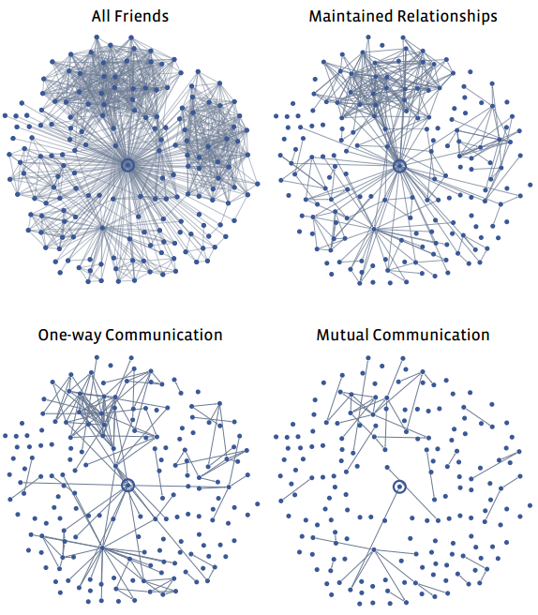
Typical User's Network
Less interest
College & high school friends?
http://overstated.net/2009/03/09/maintained-relationships-on-facebook

Slide 56
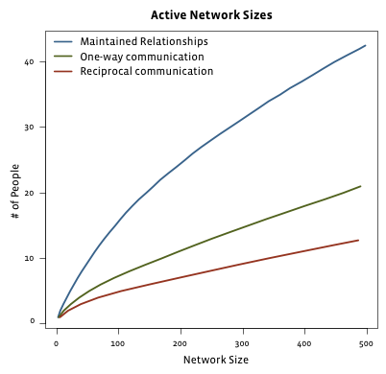
Limits to Maintaining Relationships
passive engagement
Reciprocal – messages sent both ways
One-way – at least one message sent
Maintained – user clicked on Friend's content (from feed) or profile more than once
Can't keep up with everyone!
http://overstated.net/2009/03/09/maintained-relationships-on-facebook

Slide 57
Tie Strength on Twitter
Huberman et al., Social networks that matter: Twitter under the microscope, First Monday, Jan 2009
Analyzed tie strength of 211,024 active Twitter users during observation period
Followees – people being followed
Friend – person who user has directed at least two tweets to (strong ties)

Slide 58
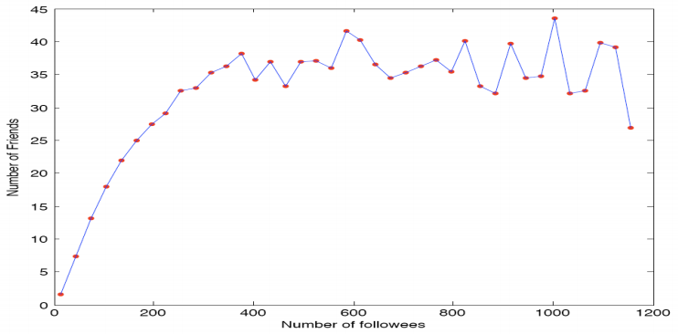
Friends vs. Followees
Limit number of strong ties a user can maintain
http://arxiv.org/pdf/0812.1045.pdf

Slide 59
Now let's look at the edges to see which nodes are “important”…

Slide 60
Edge Embeddedness
Defined as the number of common neighbors shared by two endpoints
Equal to numerator in neighborhood overlap
Local bridges have embeddedness of zero
A
Embeddedness of A-B = 1
Embeddedness of A-C = 2
B
D
C

Slide 61
Example
C
Zero embeddedness
B
A
D
All edges have high embeddedness

Slide 62
Embeddedness and Trust
Research shows that if you and I are connected by an embedded edge (we share a mutual friend), there is more trust and confidence in the integrity of the transactions (social, economic, etc.) between us
If I cheat you, our mutual friends are likely to find out, and they are less likely to trust me in the future!
Threat is absent for edges of zero embeddedness; no mutual friends to punish me!

Slide 63
C
Riskier
B
A
D
High levels
of trust
B also must deal with potentially contradictory norms and expectations from various groups

Slide 64
It's Good to be B…
Node B is at the end of multiple local bridges
Node B spans a structural hole in the network – space between two components that do not interact closely
If network represents a company or organization, some advantages for B:
B has early access to info that originates in various components
Having access to this info can amplify B's creativity by combining disparate info into novel ideas
B acts as "gatekeeper" and can control flow of information to various components
B seems “smart” to everybody else…

Slide 65
C
Riskier
B
A
D
High levels
of trust
Who would you rather be? A with trusted relationships or risk-taker B?

Slide 66
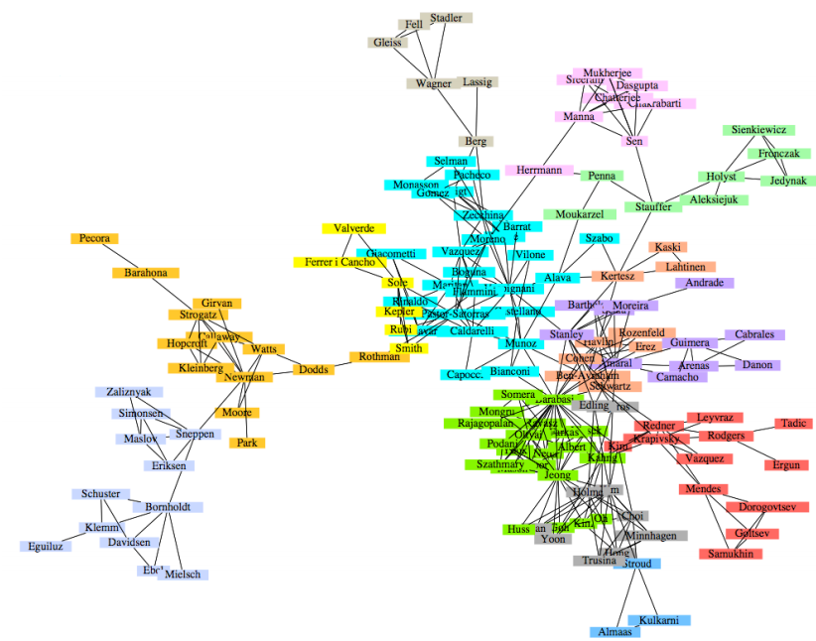
Co-authorship network How can the tightly clustered groups be identified mathematically?
We can often “eyeball” clusters, important nodes
We often are interested in link prediction
Newman & Girvan, 2004

Slide 67

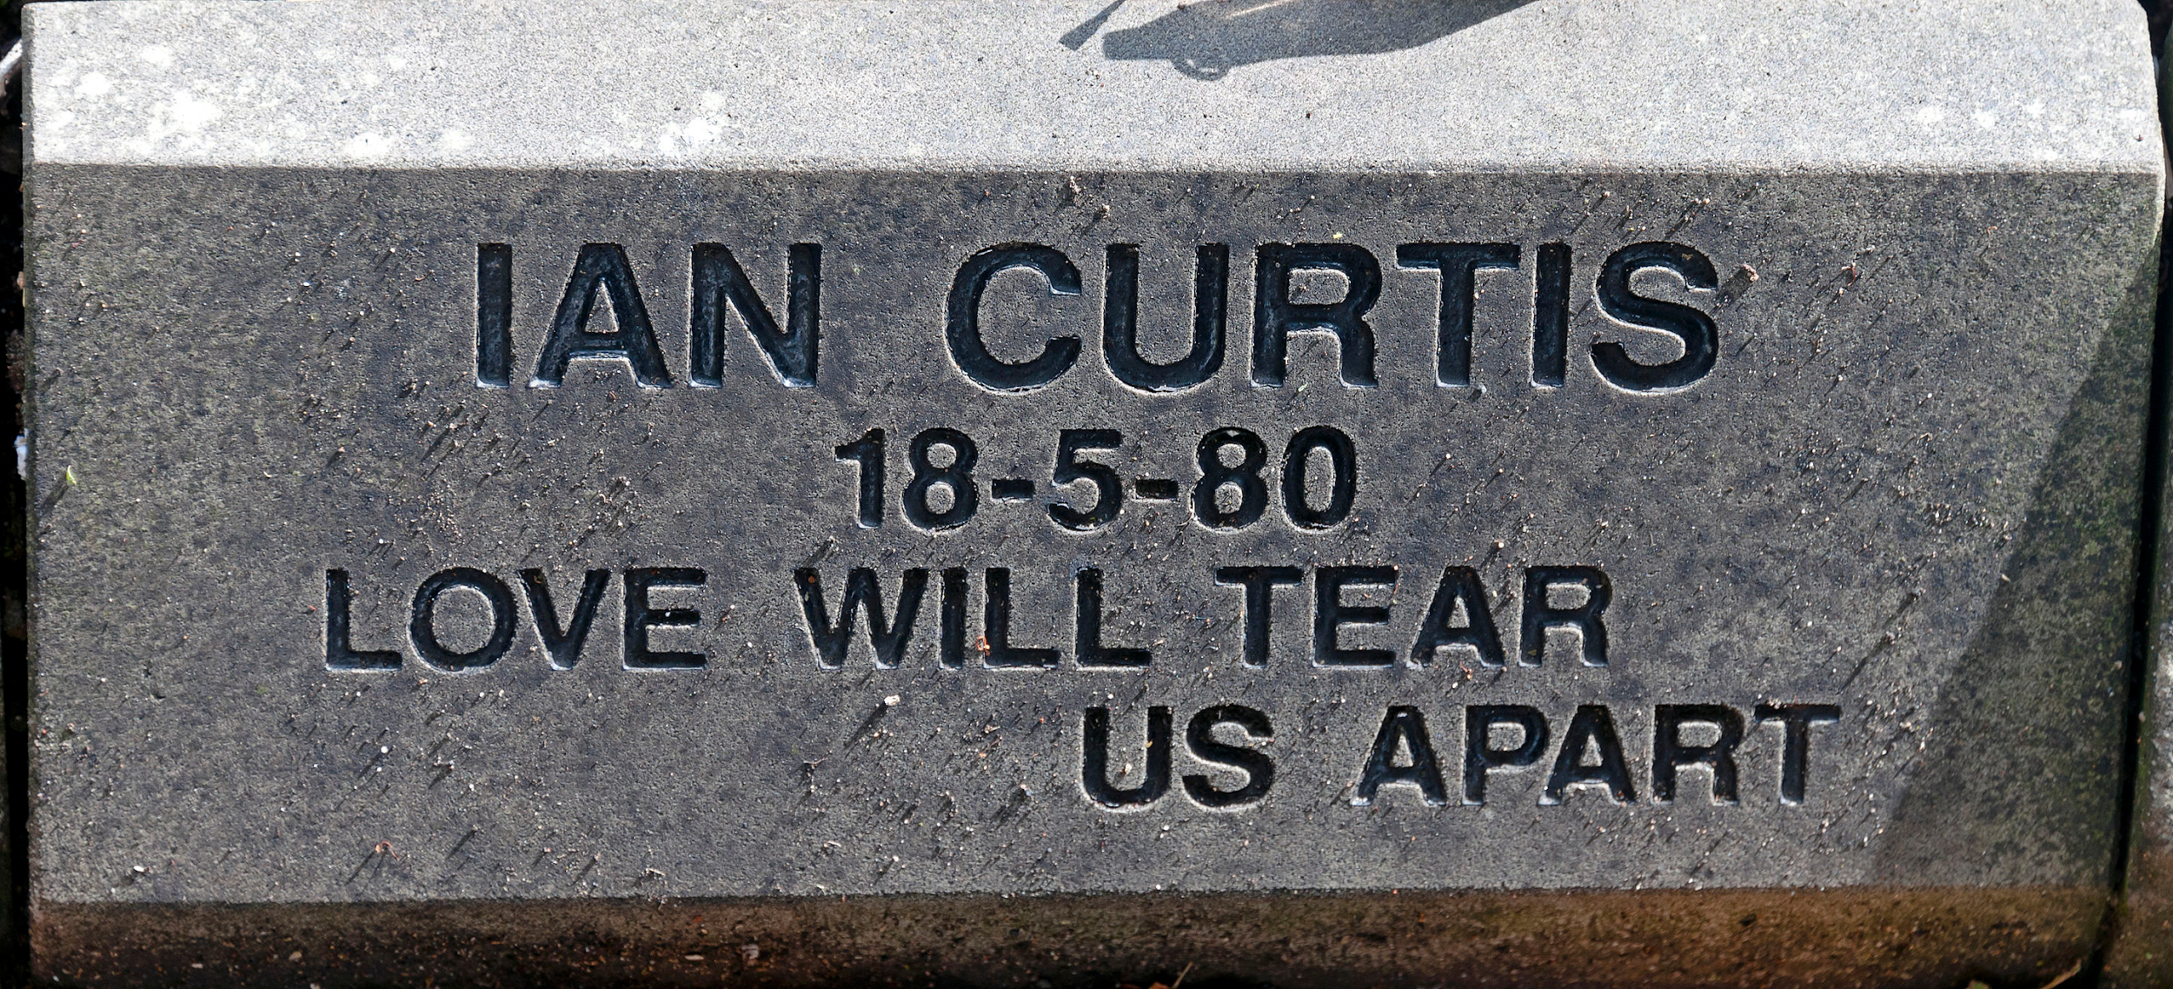
“Strong Ties Will Tear Us Apart… Again”
https://www.youtube.com/watch?v=zuuObGsB0No
https://en.wikipedia.org/wiki/Love_Will_Tear_Us_Apart

Slide 68
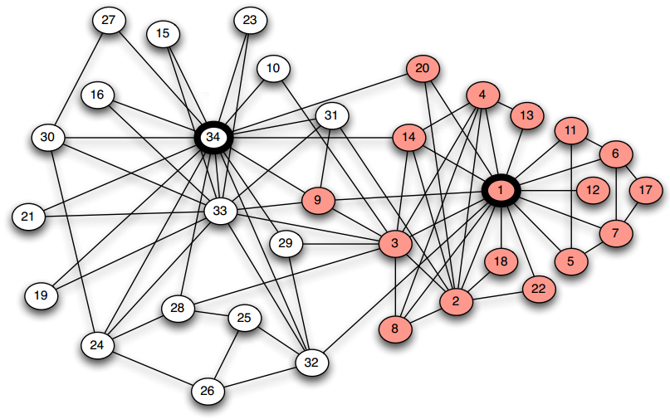
Karate Club splits after a dispute. Can new clubs be identified based on network structure?
Zachary W. (1977). An information flow model for conflict and fission in small groups. Journal of Anthropological Research, 33, 452-473.
https://en.wikipedia.org/wiki/Zachary's_karate_club
see data set at: http://konect.uni-koblenz.de/networks/ucidata-zachary and
http://vlado.fmf.uni-lj.si/pub/networks/data/ucinet/ucidata.htm#zachary

Slide 69
Graph Partitioning
Methods to break a network into sets of connected components called regions
Many general approaches
Divisive methods: Repeatedly identify and remove edges connecting densely connected regions
Agglomerative methods: Repeatedly identify and merge nodes that likely belong in the same region

Slide 70
Divisive Methods
1
10
2
3
9
11
7
8
4
6
12
13
5
14

Slide 71
Agglomerative Methods
1
10
2
3
9
11
7
8
4
6
12
13
5
14

Slide 72
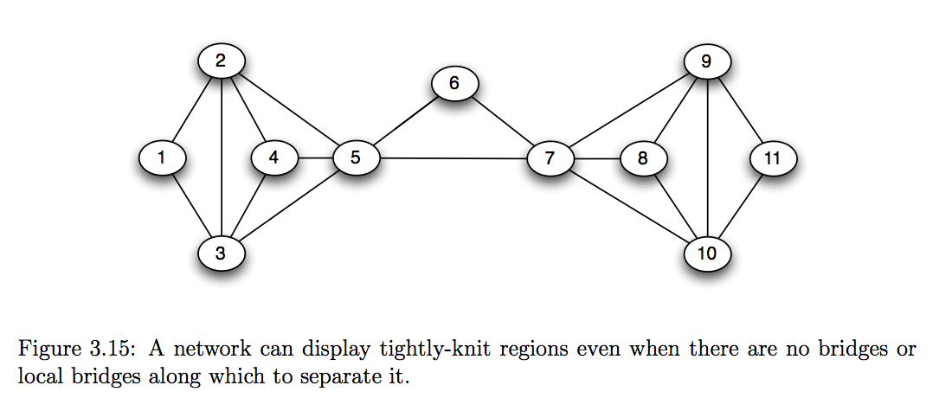
How to split/cluster?

Slide 73
Girvan-Newman Algorithm
Divisive method Proposed by Girvan and Newman in 2002
Uses edge betweenness to identify edges to remove
Edge betweenness: Total amount of "flow" an edge carries between all pairs of nodes where a single unit of flow between two nodes divides itself evenly among all shortest paths between the nodes (1/k units flow along each of k shortest paths)
betweenness is a measure of centrality, or importance, in a graph http://en.wikipedia.org/wiki/Centrality

Slide 74
Edge Betweenness Example
1
10
2
3
Calculate total flow over edge 7-8
9
11
7
8
4
6
12
13
5
14

Slide 75
1
10
2
3
One unit flows over 7-8 to get from 1 to 8
9
11
7
8
4
6
12
13
5
14

Slide 76
1
10
2
3
One unit flows over 7-8 to get from 1 to 9
9
11
7
8
4
6
12
13
5
14

Slide 77
1
10
2
3
One unit flows over 7-8 to get from 1 to 10
9
11
7
8
4
6
12
13
5
14

Slide 78
1
10
2
3
9
11
7
8
4
6
12
13
5
7 total units flow over 7-8 to get from 1 to nodes 8-14
14

Slide 79
1
10
2
3
9
11
7
8
4
6
12
13
5
7 total units flow over 7-8 to get from 2 to nodes 8-14
14

Slide 80
1
10
2
3
9
11
7
8
4
6
12
13
5
7 total units flow over 7-8 to get from 3 to nodes 8-14
14

Slide 81
7 x 7 = 49 total units flow over 7-8 from nodes 1-7 to 8-14
1
10
2
3
9
11
7
8
4
6
12
13
5
14

Slide 82
1
Edge betweenness = 49
10
2
3
9
11
7
8
4
6
12
13
5
14

Slide 83
1
10
Calculate betweenness for edge 3-7
2
3
9
11
7
8
4
6
12
13
5
14

Slide 84
1
10
3 units flow from 1-3 to each 4-14 node,
so total = 3 x 11 = 33
2
3
9
11
7
8
4
6
12
13
5
14

Slide 85
1
Betweenness = 33
for each symmetric edge
10
2
3
9
11
33
33
7
8
33
33
4
6
12
13
5
14

Slide 86
1
10
Calculate betweenness for edge 1-3
2
3
9
11
7
8
4
6
12
13
5
14

Slide 87
1
10
Carries all flow to node 1 except from node 2,
so betweenness = 12
2
3
9
11
7
8
4
6
12
13
5
14

Slide 88
1
10
betweenness = 12
for each symmetric edge
12
12
2
3
9
11
12
12
7
8
4
12
6
12
12
13
12
12
5
14

Slide 89
1
10
Calculate betweenness for edge 1-2
2
3
9
11
7
8
4
6
12
13
5
14

Slide 90
1
10
Only carries flow from 1 to 2, so betweenness = 1
2
3
9
11
7
8
4
6
12
13
5
14

Slide 91
1
10
betweenness = 1 for each symmetric edge
1
1
2
3
9
11
7
8
4
6
12
13
1
1
5
14

Slide 92
1
10
Edge with highest betweenness
1
12
12
1
2
3
9
11
12
12
33
33
7
49
8
33
33
4
12
6
12
12
13
1
12
12
1
5
14

Slide 93
Detour: Node Betweenness
Betweenness also defined for nodes
Node betweenness: Total amount of "flow" a node carries when a unit of flow between each pair of nodes is divided up evenly over shortest paths
Nodes and edges of high betweenness perform critical roles in the network structure

Slide 94
Detour: Node Betweenness
1
10
2
3
9
11
7
8
C_{b}(7) = (10*3) /
((N-1)(N-2)/2)
= 30 / ((13*12)/2)
= 0.385
4
6
12
13
5
14
For nodes 1, 2, and 3, the shortest path to the 10 remaining nodes in the graph (not counting 7) all go through 7.
The graph is undirected, so calculating the shortest path for (1,10), for example, is the same as (10,1).

Slide 95
Girvan-Newman Algorithm
Calculate betweenness of all edges
Remove the edge(s) with highest betweenness
Repeat steps 1 and 2 until graph is partitioned into as many regions as desired

Slide 96
Girvan-Newman Algorithm
Calculate betweenness of all edges
Remove the edge(s) with highest betweenness
Repeat steps 1 and 2 until graph is partitioned into as many regions as desired
How much computation does this require?
Newman (2001) and Brandes (2001) independently developed similar algorithms that reduce the complexity from O(mn²) to O(mn) where m = # of edges, n = # of nodes

Slide 97
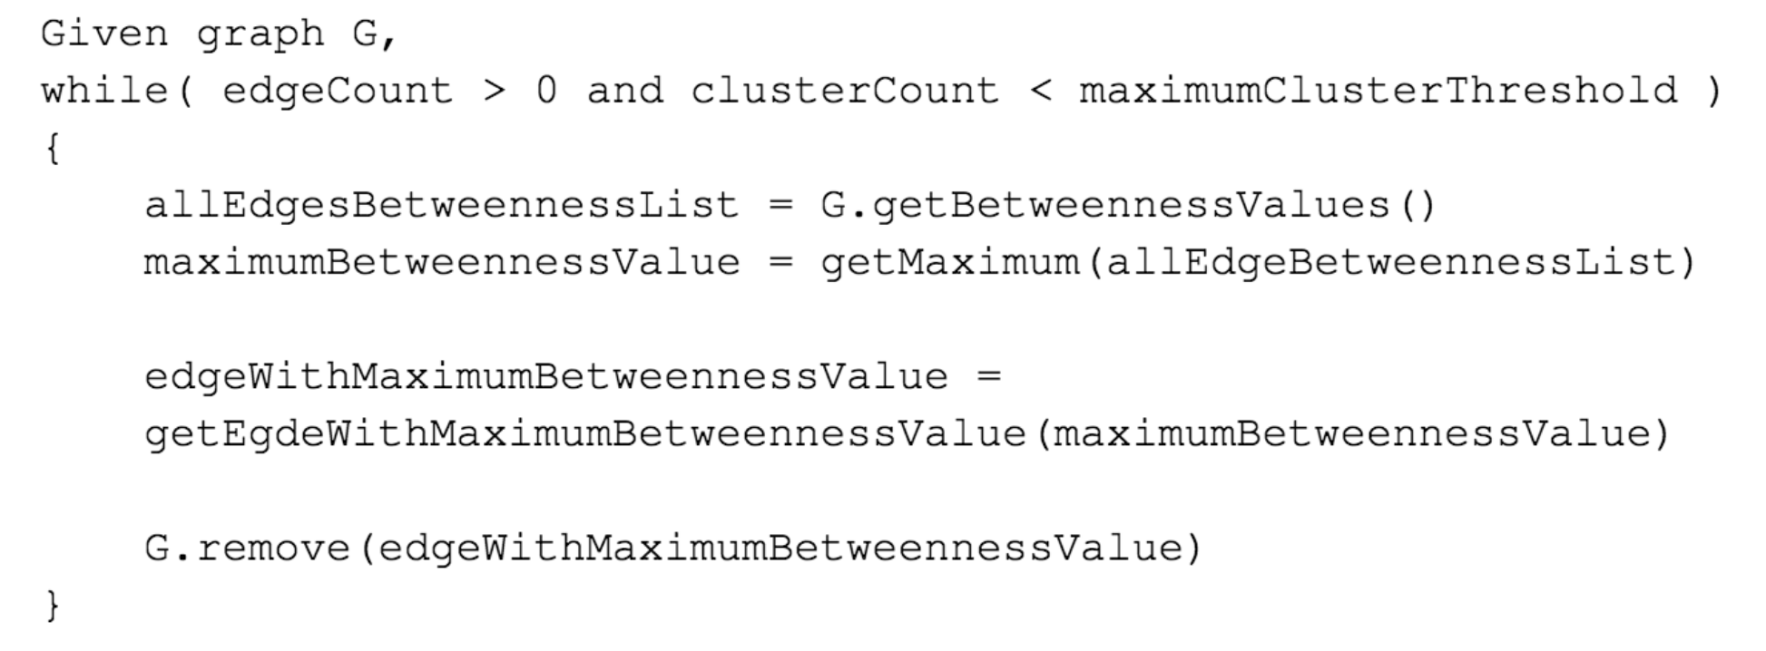
Girvan-Newman Pseudocode

Slide 98
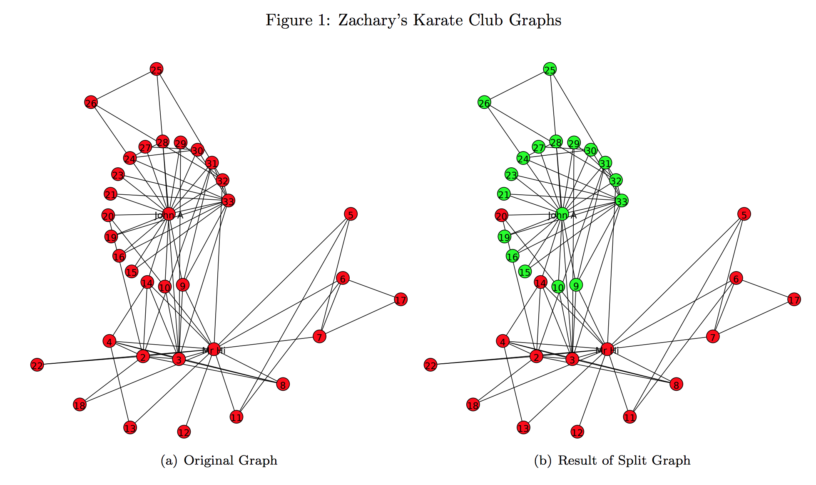
Girvan-Newman run on Karate-Club graph

Slide 99
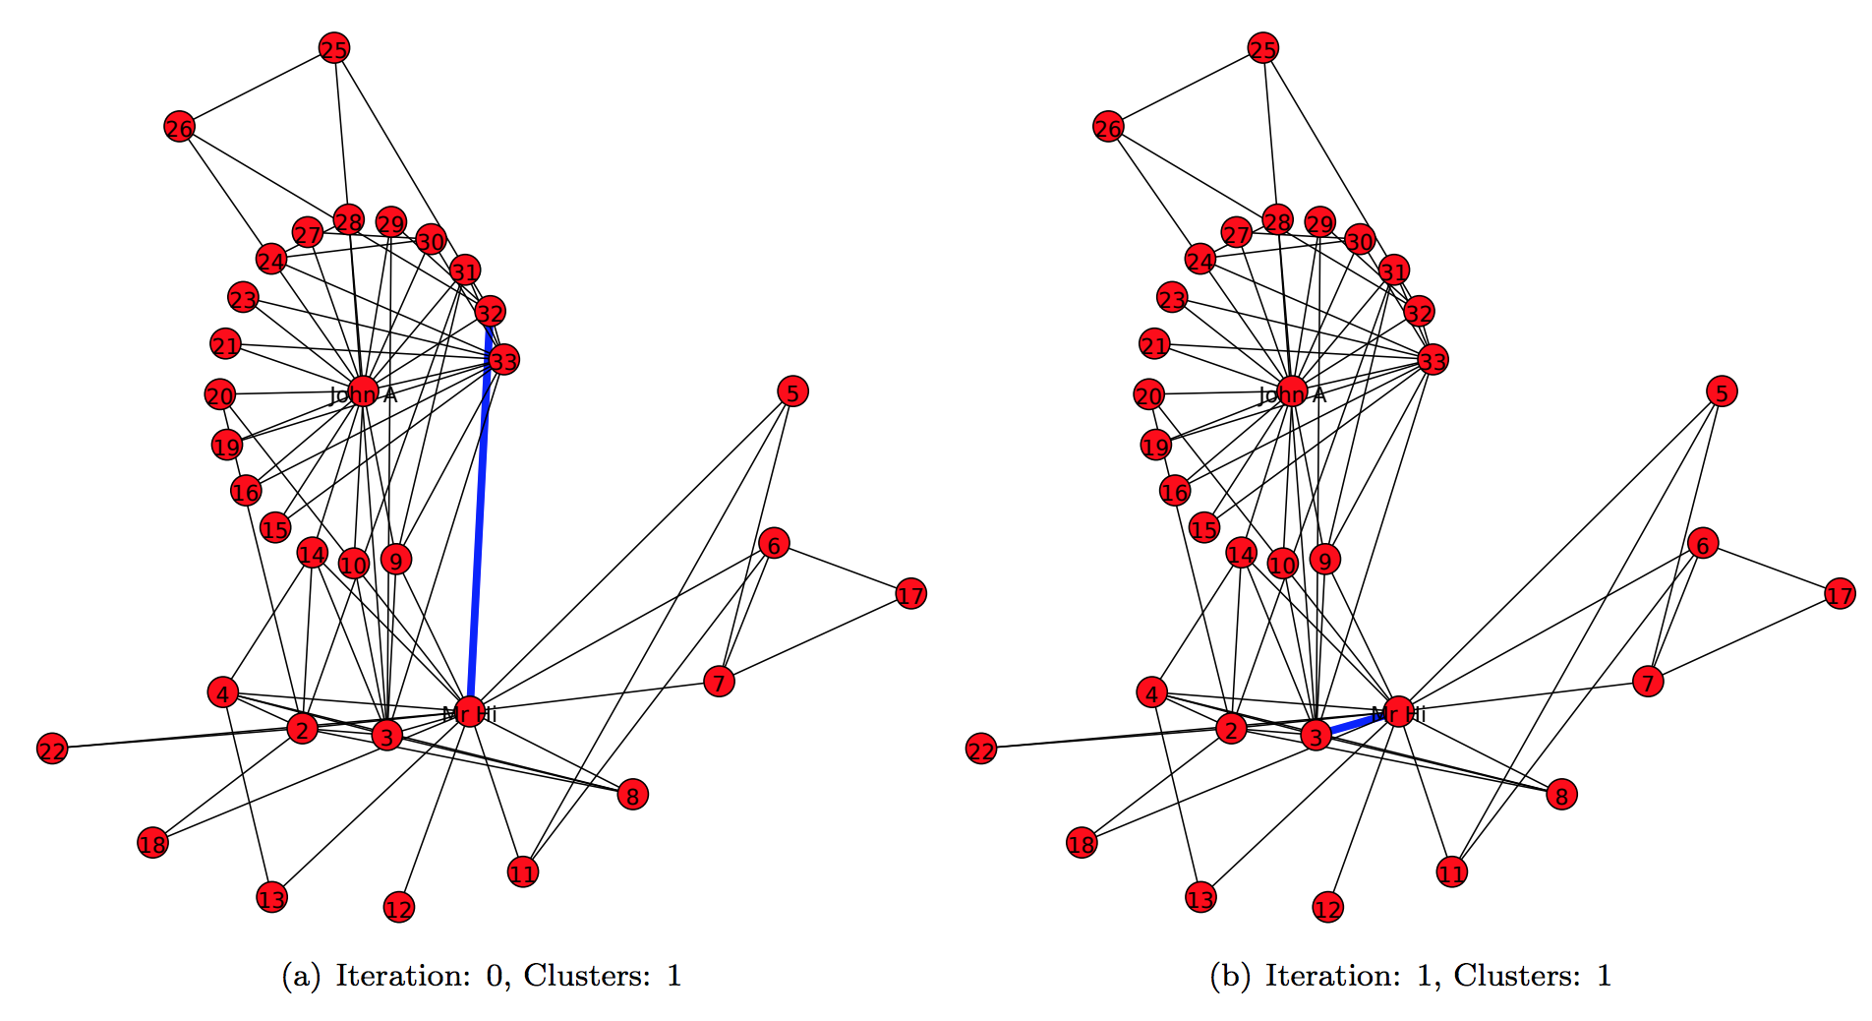
Girvan-Newman run on Karate-Club graph

Slide 100
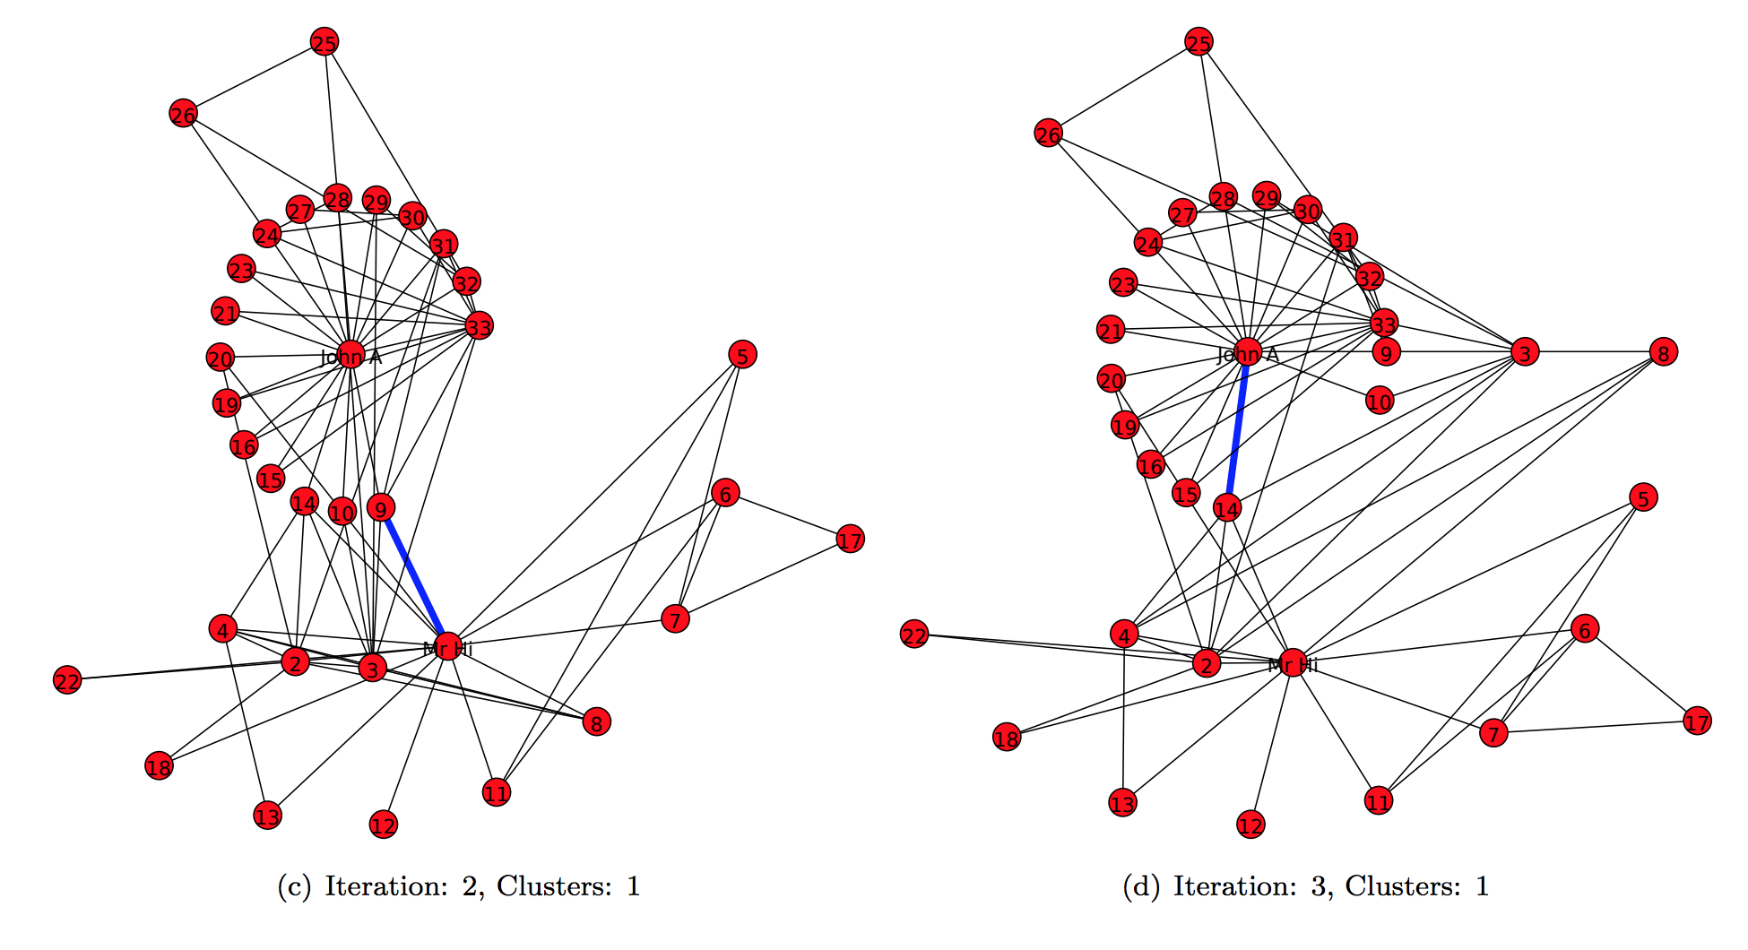
Girvan-Newman run on Karate-Club graph

Slide 101
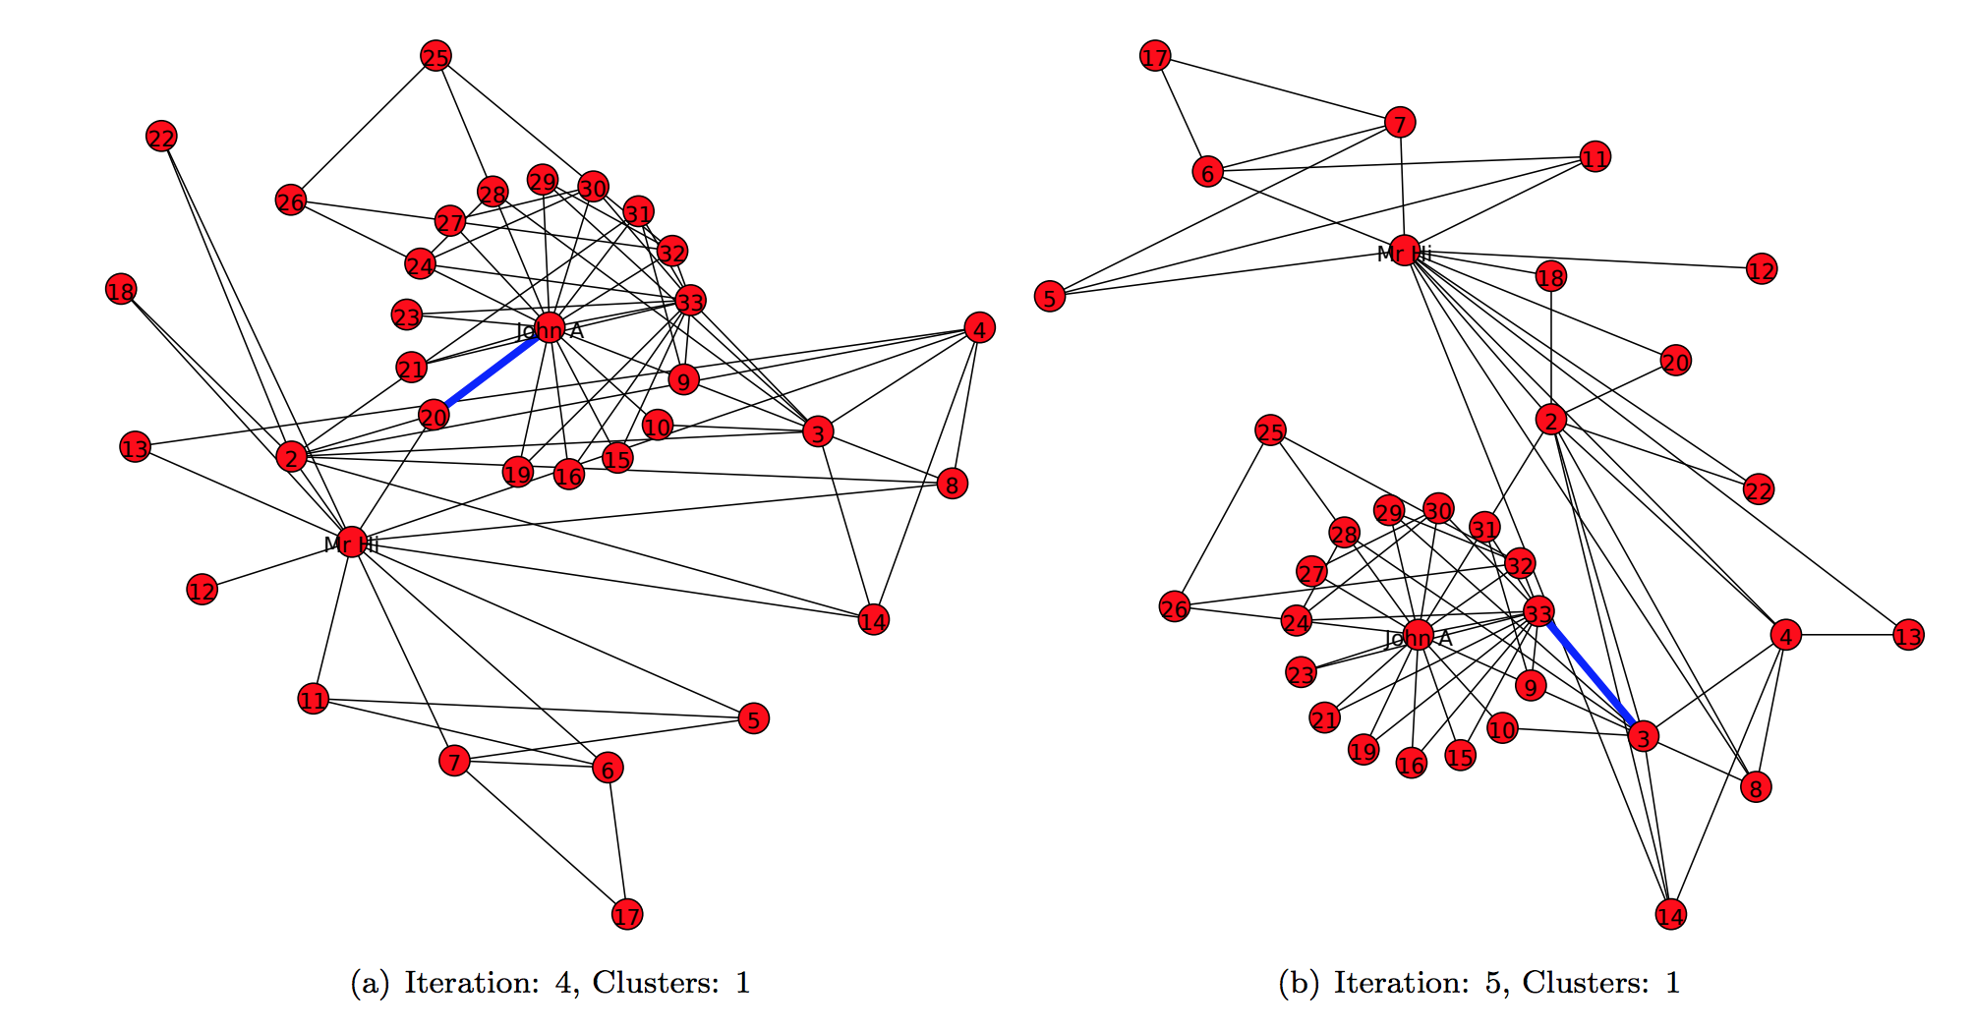
Girvan-Newman run on Karate-Club graph

Slide 102
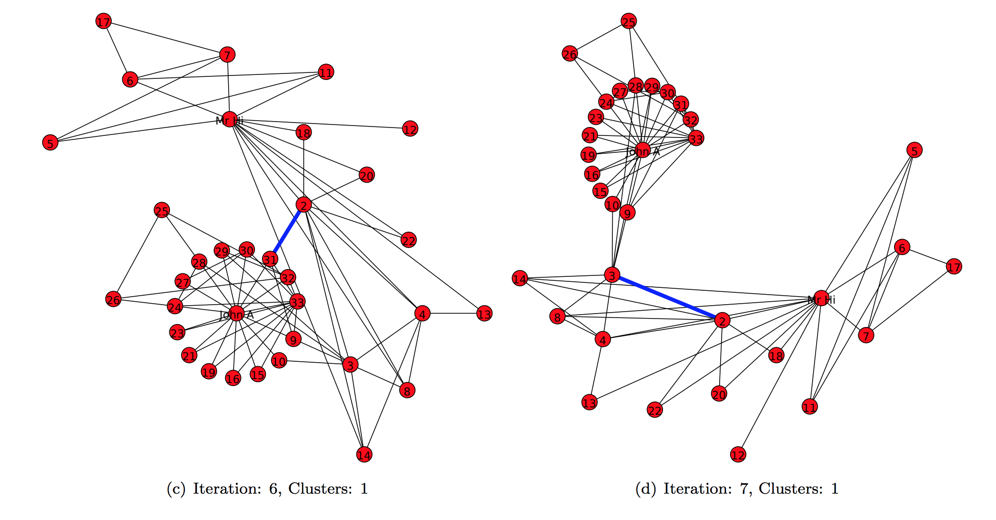
Girvan-Newman run on Karate-Club graph

Slide 103
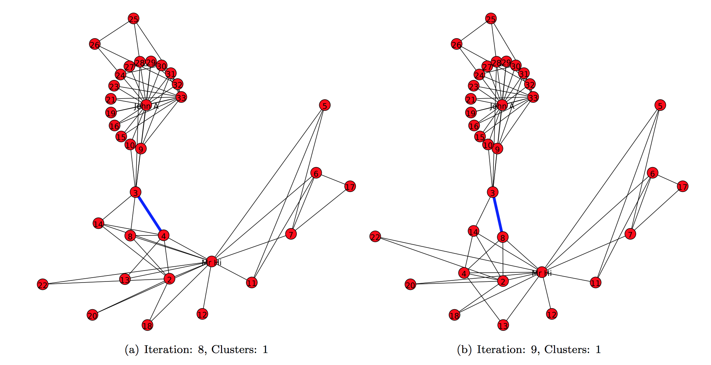
Girvan-Newman run on Karate-Club graph

Slide 104
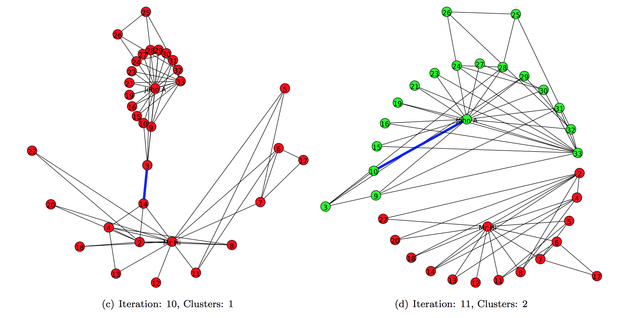
Girvan-Newman run on Karate-Club graph

Slide 105
Computing Edge Betweenness Efficiently
For each node N in the graph
Perform breadth-first search of graph starting at node N
Determine the number of shortest paths from N to every other node
Based on these numbers, determine the amount of flow from N to all other nodes that use each edge
Divide sum of flow of all edges by 2
Method developed by Brandes (2001) and Newman (2001)

Slide 106
Other Helpful Resources
Bibliography of Research on Social Network Sites http://www.danah.org/researchBibs/sns.php
Christakis and Fowler, Connected (2009)
Kadushin, Understanding Social Networks (2011)

